Slide 1




Smart Sleep-Regulating Pillow
Presented By Group-2

Slide 2




Our Team
1. Kavya Gupta(23BAI10538)
2. Himanshu Gaur(23BCY10127)
3. Vansh Vardan(23BAI10700)
4. Ankit Dey(23BAI10488)
5. Gaurav Gupta(23BAI10357)

Slide 3


Introduction
Sleep is essential for mental and physical well-being, yet modern lifestyles often lead to poor sleep quality.
Traditional pillows provide comfort but lack the ability to adapt to individual sleep needs or offer any health insights.
Over the decades, pillows have evolved—from basic cotton and memory foam to today’s smart pillows with embedded technology.
The Smart Sleep-Regulating Pillow is a next-generation innovation combining AI, biometric sensors, and IoT to personalize and enhance the sleeping experience.
Current smart pillows (e.g., ZEEQ, Motion Pillow) offer features like snore detection and app connectivity but face challenges like:
High cost
Limited battery life
Data privacy concerns
Lack of real-time adaptability
The goal of our project is to develop a fully autonomous, intelligent pillow that not only provides comfort but also actively improves sleep quality and monitors health.
Real-life use case: A person with undetected sleep apnea could benefit from a smart pillow that tracks breathing patterns, detects anomalies, and alerts them or their doctor—potentially preventing serious health issues.

Slide 4

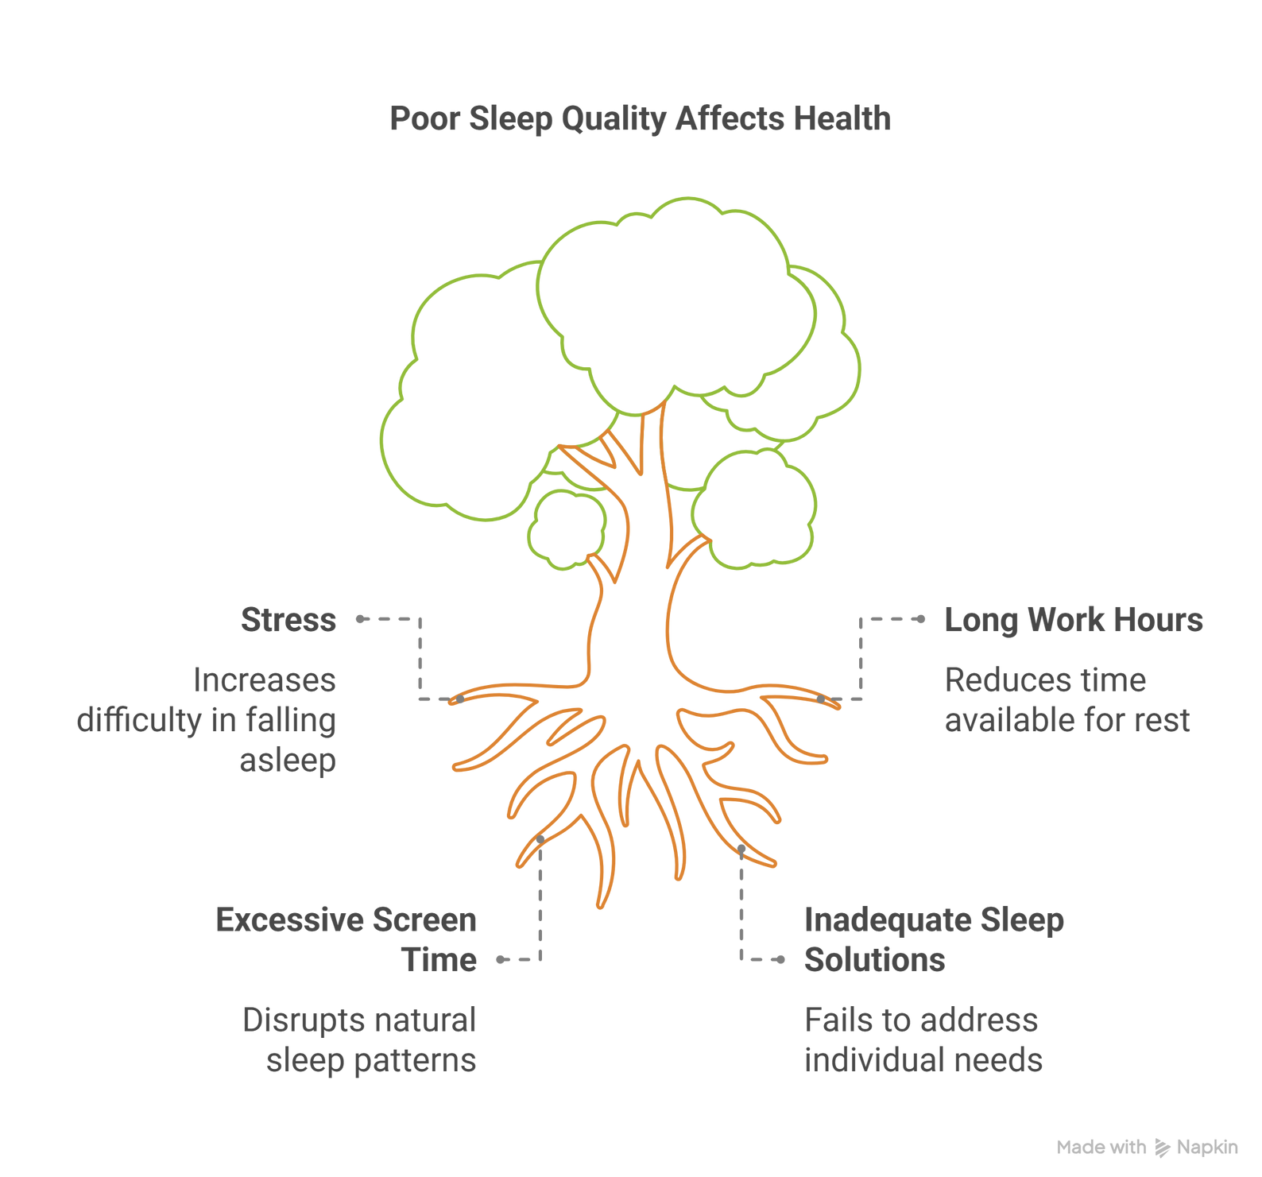


Slide 5
Human-Centered Design Process for Smart Sleeping Pillow
1. Observation: Observe users' sleeping habits—do they snore, toss and turn, overheat at night, or struggle with neck support?
2. Ideation: Brainstorm creative solutions based on user needs like A pillow that feels like a normal one but has soft, hidden sensors or an app that shows simple sleep scores, not confusing graphs.
3. Rapid Prototyping: Create a basic pillow with foam, small sensors, and sound output. Design a simple app interface showing sleep score and tips.
4. User Feedback: Users test the smart pillow for a week and give feedback like:
“The sensors are too hard.”
“App should be easier to understand.”

Slide 6
Human-Centered Design Process for Smart Sleeping Pillow
5. Iteration: Improve the design based on feedback.
Example:
Use softer, textile-based sensors.
Make the app cleaner with larger fonts and fewer graphs.
6. Implementation: Manufacture the smart pillow with all improved features and release it along with the mobile app, ensuring user-friendly packaging and setup guide.
Final Goal:
Create a smart pillow that truly helps people sleep better—because it was designed with users at the center, every step of the way.

Slide 7




Product Overview
The smart pillow is an innovative sleep aid designed to enhance sleep quality using built-in sensors and smart features.
It combines comfort with technology, tracking sleep patterns, offering audio support, and promoting better rest.

Slide 8

Key Features
Sleep Tracking: Built-in sensors monitor sleep duration, quality, and movement throughout the night.
Temperature Control: Adjustable heating/cooling to maintain optimal sleeping temperature.
Built-in Speakers: Allows users to listen to white noise, calming music, or guided meditation without external headphones.
Smart Alarm: Wakes users during the lightest sleep phase using gentle vibrations or audio for a refreshed feeling.

Slide 9
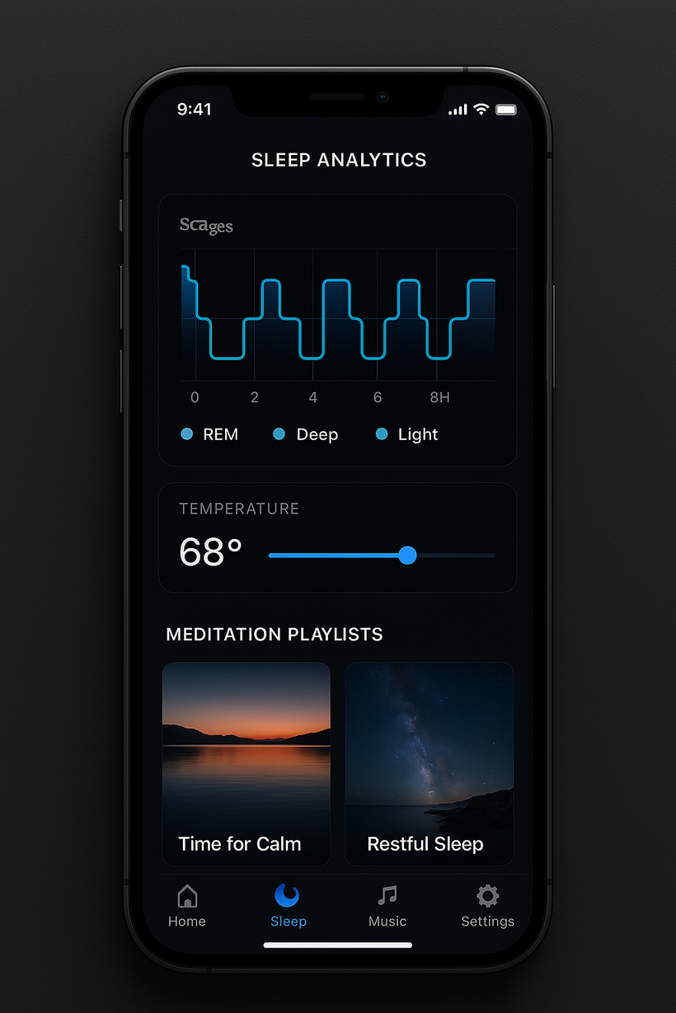
Key Features
Bluetooth Connectivity: Syncs with a mobile app for sleep data visualization and settings customization.
Posture Detection: Helps users maintain a healthy neck position and alerts for bad posture (optional feature).
Memory Foam or Gel Material: Ensures comfort, adapts to head/neck shape for optimal support.

Slide 10
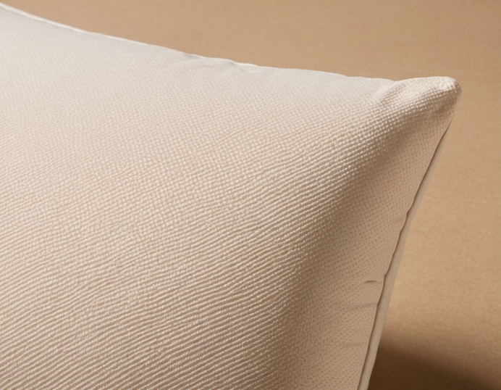
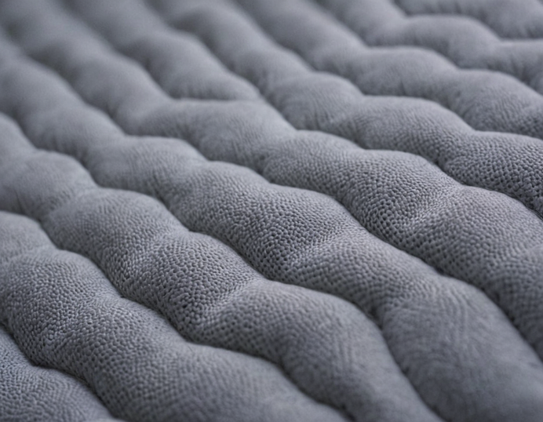
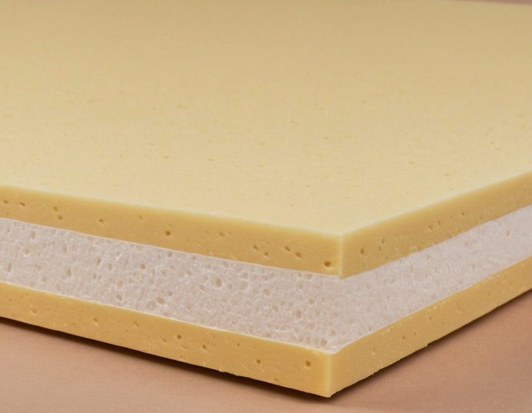
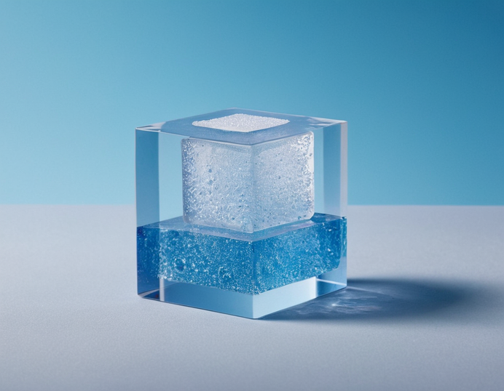
Materials Used..
Materials Used..
hypoallergenic
Breathable Outer Fabric
Inner Memory Foam Core
Gel-Infused Foam Layer
🌿 (Tencel)
💨 (3D Spacer Mesh)
🚀 (NASA-Tech Foam)
❄️ (PCM Gel)

Slide 11


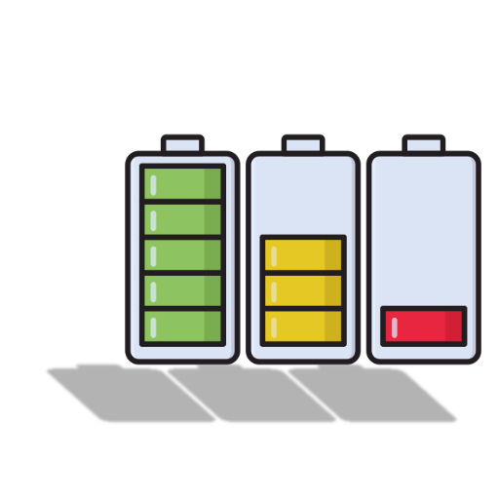

Power Source
-Never Run Out of Power – Sleep Smart Anywhere
Rechargeable battery with a USB-C port.
Battery life: 5–7 days on a single charge.

Slide 12
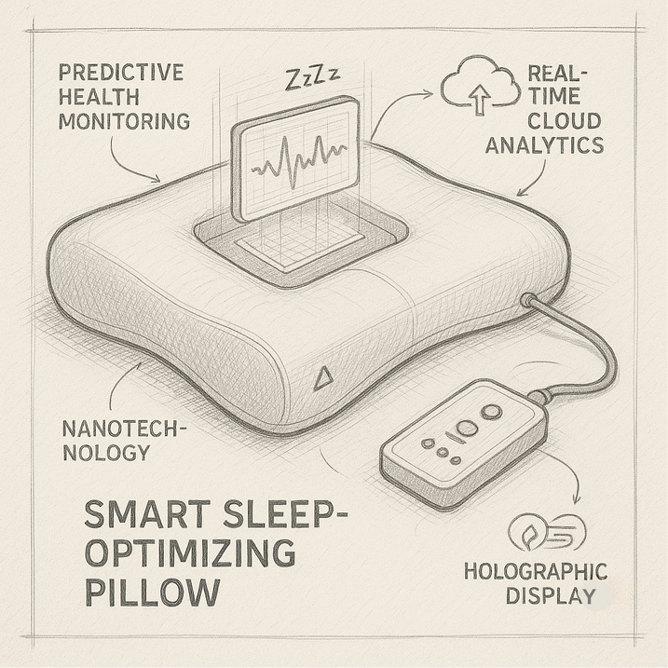
Key Functions of the Smart Pillow
Nanotechnology: Adapts to user’s sleep posture and temperature in real-time.
Predictive Health Monitoring: Tracks vitals (heart rate, breathing, etc.) while sleeping.
Holographic Display: Shows sleep analytics and health alerts instantly.
Real-Time Cloud Analytics: Syncs data securely for review by health apps or professionals.

Slide 13
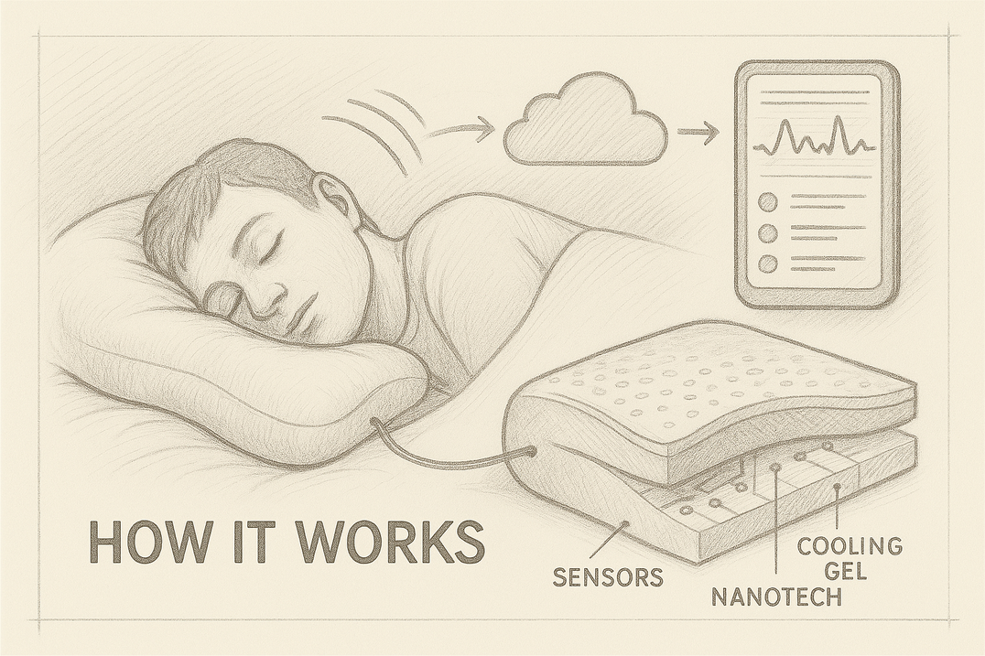
Inside the Pillow
Sensors Embedded in Pillow Core: Monitor motion, temperature, and bio-signals.
AI Algorithms: Adjust pillow firmness and temperature dynamically.
Remote Access: Family or doctors can monitor critical stats.
Eco-friendly Materials: Sustainable, hypoallergenic, and safe.

Slide 14
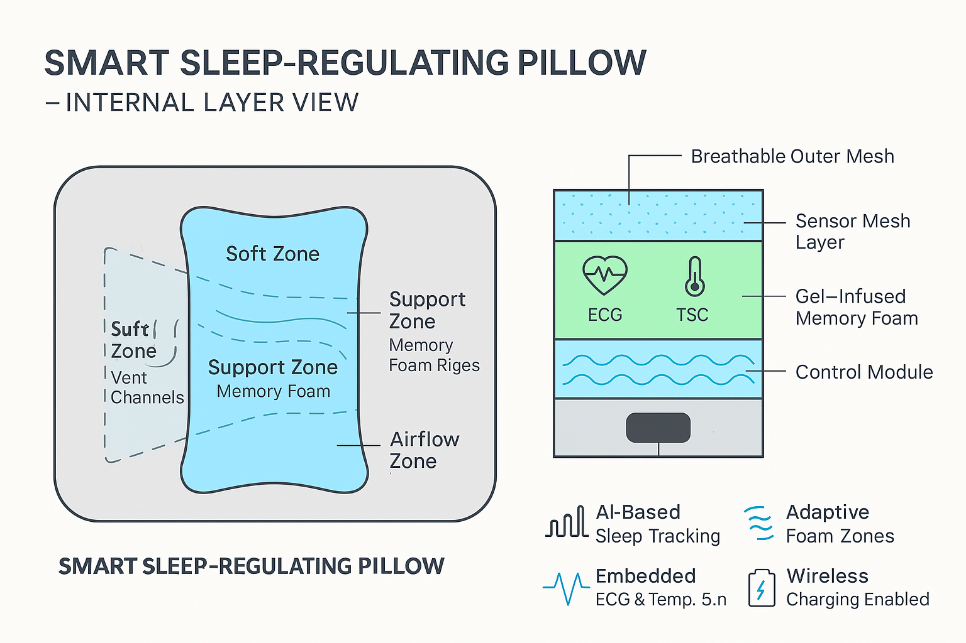

Slide 15
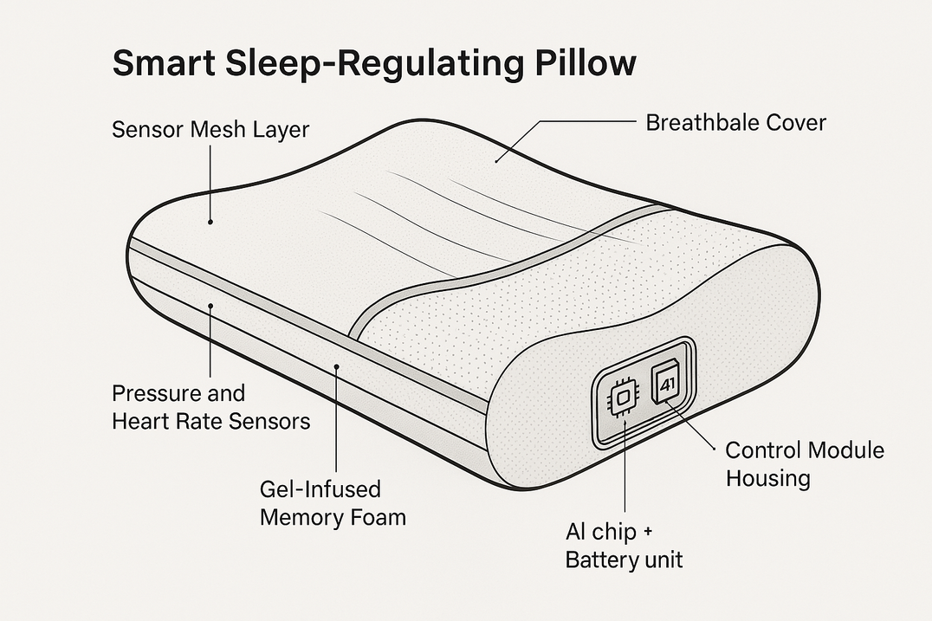
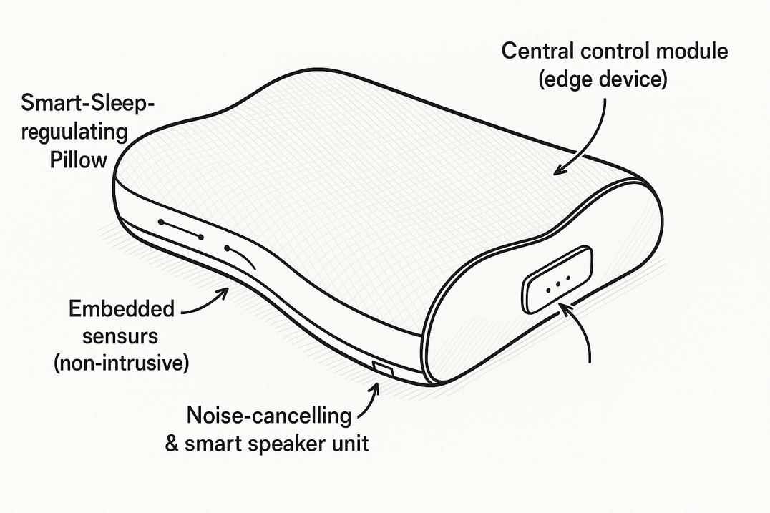
Future Design Scope

Slide 16






Thank You

